Slide 1
Darcy’s Law in Multiple Dimensions
CE 544 – BRIGHAM YOUNG UNIVERSITY

Slide 2
Darcy’s Law in 2D
Isotropic medium

Slide 3
Anisotropic Medium
s
k_{min}
k_{max}
r
= "conductivity matrix" or "conductivity tensor"
r & s may or may not coincide with x & y

Slide 4
Example
y
s
k_{min}
x
k_{max}
r
Bedding Planes
You often need k in terms of x & y (k_{x}, k_{y}).

Slide 5
Coordinate Transformation
y
s
r
α
x

Slide 6
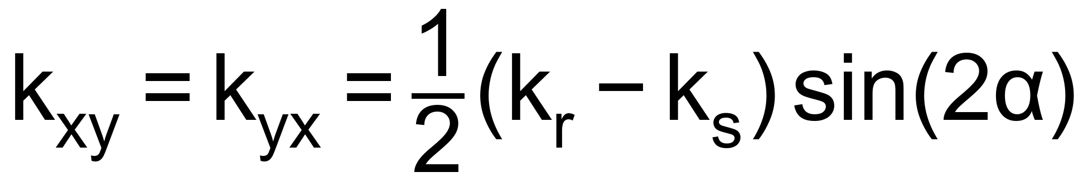
Coord. Transformation, cont.
Solving in terms of k_{r} and k_{s}:

Slide 7
Darcy’s Law in 3D
v_{z}
z
v_{x}
x
v_{y}
y
If x, y, and z axes coincide with principal axes of permeability:
In most cases
k_{xx} = k_{yy}
k_{xx} > k_{zz}

Slide 8
Darcy’s Law in 3D, cont.
General case:
The tensor is symmetric, i.e.:
  k_{yx} = k_{xy}
  k_{zx} = k_{xz}
  k_{zy} = k_{yz}

